Slide 1
Parking Spot Indicator In Vicinity
PIP104 PROFESSIONAL PRACTICE-II
VIVA-VOCE
Batch Number:UP-151
Roll Number | Student Name
20201COD0012 | HARI TEJA A V
20201COD0015 | G. CHETHAN REDDY
20201COD0031 | G. SANDEEP REDDY
20201COD0035 | TALARI NARENDRA
20201COD0040 | SHAIK ARSHADH
Under the Supervision of,
Ms. Yogeetha BR
Associate Professor – Selection Grade
School of Computer Science Engineering
Presidency University

Slide 2
Introduction
In an era characterized by rapid urbanization and burgeoning population growth, the demand for efficient and intelligent urban infrastructure becomes imperative. Parking management, a critical component of urban planning, is confronted with challenges such as congestion, inadequate space utilization, and the need for real-time monitoring. This project endeavors to address these challenges through the implementation of a sophisticated Parking Spot Indicator with Vicinity, designed to elevate the standard of parking space management. The essence of this initiative lies in leveraging cutting-edge technologies, specifically image processing and computer vision, to create a dynamic and responsive system. Aimed at optimizing parking space utilization, the project targets temporary parking areas, where conventional parking systems are often absent. By utilizing a web-based interface, this system seeks to provide users with real-time insights into parking space availability within a designated vicinity.

Slide 3
Literature Review
The literature on smart parking systems encompasses a diverse range of approaches and technologies aimed at optimizing parking space utilization. Parikh et al.'s "Park Indicator" proposes a parking spot reservation system, highlighting the potential for addressing the challenge of finding available parking spaces efficiently (Parikh et al., n.d. [1]). Reinhard Hössinger et al. contribute by developing a real-time model for short-term parking zones, offering insights into improving occupancy predictions and enhancing parking management (Reinhard Hössinger et al., n.d. [2]).
Sarfraz Nawaz et al. introduce "ParkSense," a smartphone-based sensing system for on-street parking, suggesting a move towards more accessible and user-friendly parking solutions (Sarfraz Nawaz et al., n.d. [3]). Selcuk Demir et al.'s work focuses on the selection of suitable parking lot sites in megacities, emphasizing the importance of strategic planning in addressing parking space challenges (Selcuk Demir et al., n.d. [4]).
Image-based parking solutions are explored by Xie et al., who present a method for identifying parking places for shared bicycles, contributing to the broader discussion on efficient urban mobility (Xie et al., n.d. [5]). Yanfeng Geng et al. present a comprehensive "Smart Parking" system infrastructure, shedding light on the implementation aspects of intelligent parking solutions (Yanfeng Geng et al., n.d. [6]).

Slide 4
Literature Review
The integration of RFID technology is a prominent theme in the literature. Jian et al. propose a modular RFID parking management system, emphasizing seamless integration with existing gate systems for efficient parking control (Jian et al., 2008 [9]). Tsiropoulou et al.'s RFID-based smart parking management system extends the discussion, providing insights into the cyber-physical aspects of such systems (Tsiropoulou et al., 2017 [10]).
Wireless sensor networks are explored by Bi et al., who present a parking management system based on this technology, highlighting the potential for real-time data collection to enhance parking space utilization (Bi et al., 2006 [12]). Vera-Gómez et al.'s intelligent parking management system for urban areas integrates various technologies, offering a holistic solution to urban parking challenges (Vera-Gómez et al., 2016 [13]).
Finally, Gandhi et al.'s IoT-based car parking management system prototype introduces the concept of smart cities, emphasizing the role of the Internet of Things in creating efficient and connected urban environments (Gandhi et al., 2016 [14]). Hamada et al.'s work on surround view-based parking lot detection and tracking contributes to the discussion by exploring advanced computer vision techniques for parking space identification (Hamada et al., n.d. [15]).

Slide 5
RESEARCH GAPS OF EXISTING METHODS
The literature on smart parking systems, while diverse and insightful, reveals certain research gaps that warrant further exploration. Parikh et al.'s "Park Indicator" introduces a reservation system for parking spots, but there is a lack of discussion on the scalability and adaptability of such systems, particularly in high-density urban areas (Parikh et al., n.d. [1]). Reinhard Hössinger et al.'s real-time model for short-term parking zones provides valuable insights, yet there is a research gap in understanding the adaptability of such models to various urban settings and the integration of predictive analytics for future parking demand (Reinhard Hössinger et al., n.d. [2]).
"Sarfsense" by Sarfraz Nawaz et al. focuses on smartphone-based sensing for on-street parking, but there is a need for further investigation into the privacy and security implications of utilizing personal devices for parking management (Sarfraz Nawaz et al., n.d. [3]). Selcuk Demir et al.'s study on selecting suitable parking lot sites in megacities addresses strategic placement, yet research gaps exist in exploring the socio-economic impact of these parking lot selections on local communities and businesses (Selcuk Demir et al., n.d. [4]).

Slide 6
Proposed Methodology
.
Capture Live Video Stream:
The system initiates by obtaining a live video stream of the parking lot through a camera.
Image Capture on Car Movement:
Images are captured dynamically when a car either enters or exits the parking lot, allowing the system to focus on relevant moments.
Conversion to Gray Scale:
The RGB images acquired are transformed into gray scale images, simplifying subsequent processing steps.

Slide 7
Proposed Methodology
.
Calibration:
Calibration is conducted to refine the focus of the algorithm. Firstly, the system identifies and selects the coordinates defining the boundaries of the parking lot. This step effectively crops any extraneous areas beyond the parking lot, optimizing the computational resources. Secondly, the algorithm identifies and selects the coordinates of a single parking slot, effectively dividing the parking lot into uniform slots.
Binary Conversion:
Each block within the defined parking slots undergoes a conversion from gray scale to binary. Subsequently, an inverse binary transformation is applied to accentuate the presence of a car, represented in white, against the background of the parking area in black

Slide 8
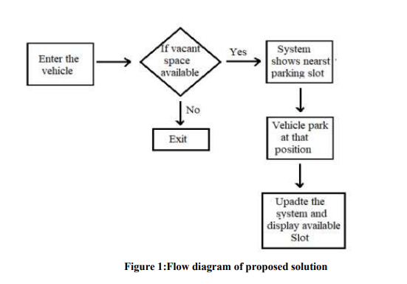
Proposed Methodology
Techniques like object detection or background subtraction are explored to accurately identify the presence of vehicles in the captured images. Algorithms for counting available parking spaces within the detected Region of Interest (ROI) are developed, with potential integration of machine learning models for improved accuracy

Slide 9
Objectives
1. Capture and Detect Vehicle Presence:
Develop an image processing technique to accurately capture and detect the existence of vehicles in a parking lot using surveillance cameras.
2. Count and Display Available Parking Space:
Implement a system that counts and displays the number of available parking spaces in real-time, providing valuable information to drivers entering the parking lot.
3. Optimized Parking:
Aim to optimize parking space utilization, ensuring that users find the best available spot, saving time and resources for both individual drivers and commercial entities.
4. Traffic Flow Improvement:
Reduce traffic congestion by providing accurate information on available parking spaces, minimizing the need for drivers to circle in search of an open spot.
5. Environmental Impact Reduction:
Address the environmental impact of parking by decreasing the time spent searching for parking, ultimately reducing vehicle emissions and environmental footprint

Slide 10
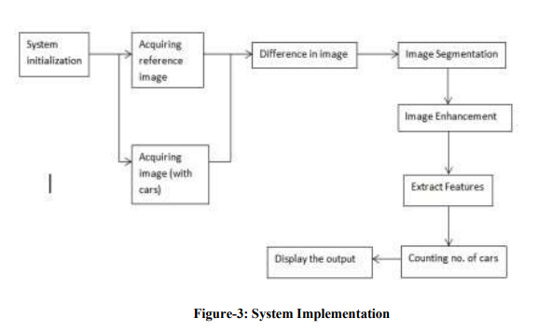
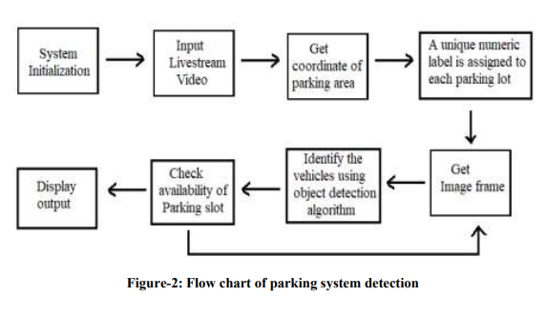
System Design & Implementation

Slide 11
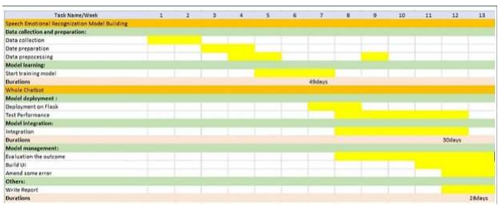
Timeline of Project

Slide 12
Outcomes / Results Obtained
Data Analytics for Future Planning:
Utilize the data collected through the smart parking system for comprehensive analytics. This data-driven approach can offer insights into patterns, peak hours, and popular parking spots, enabling informed decision-making for future urban planning and infrastructure development.
Integration with Navigation Apps:
Collaborate with popular navigation applications to seamlessly integrate smart parking information. This ensures that drivers receive updates on parking availability as part of their route planning, promoting a more efficient and hassle-free commuting experience. Features: Incorporate features that cater to individuals with special needs, such as designated accessible parking spaces and user interfaces designed for those with disabilities. This ensures inclusivity and compliance with accessibility standards.
Scalability and Interoperability:
Design the smart parking solution with scalability and interoperability in mind. This allows for easy expansion to accommodate demands and ensures compatibility with future technologies and innovations in the smart city ecosystem

Slide 13
Conclusion
The development and implementation of our Smart Parking System using Image Processing have yielded a comprehensive solution to address the challenges associated with parking space availability and management. The system, aptly named CAPSuIP (Counting Available Parking Space using Image Processing), leverages advanced image processing techniques to not only detect the presence of vehicles in a parking lot but also provide real-time information on the number and location of available parking spaces. Through a meticulous review of existing parking detection methods and a thorough examination of their advantages and disadvantages, we identified the need for a cost-effective, accurate, and user-friendly solution. CAPSuIP aims to fulfill these requirements by offering a simplified yet robust approach to parking management. The project's objectives were well-defined, focusing on crucial aspects such as optimizing parking, reducing traffic congestion, minimizing environmental impact, and enhancing user experience. The integration of features like real-time wrong parking detection, dynamic pricing, and accessibility considerations further strengthens the system's functionality and usability.

Slide 14
References
[1]Parikh, S. P., Shah, D. R., & Shah, P. R. (n.d.). Park Indicator: Book Your Parking Spot.
[2]Reinhard Hössinger, P. W. (n.d.). Development of a Real-Time Model of the Occupancy of Short-Term Parking Zones.
[3]Sarfraz Nawaz, C. E. (n.d.). ParkSense: a smartphone based sensing system for on-street parking.
[4]Selcuk Demir, M. B. (n.d.). Selection of suitable parking lot sites in megacities: A case study for four districts of Istanbul.
[5]Xie, S., Li, Y., Xu, Q., Fang, F., & Li, L. (n.d.). Image-based Parking Place Identification for Regulating Shared Bicycle Parking.
[6]Yanfeng Geng, C. G. (n.d.). A new “Smart Parking” System Infrastructure and Implementation.
[7]Benjamin Kommey, E. O. (2018). A Smart Image Processing-based System for Parking.
[8] Rashid, M. M., Musa, A., Rahman, M. A., Farahana, N.: Automatic parking management system and parking fee collection based on number plate recognition. International Journal of Machine Learning and Computing, vol. 2, no. 2, p. 94 (2012).
[9] Jian, M. S., Yang, K. S., and Lee, C. L. Modular RFID parking management system based on existed gate system integration. WSEAS Transactions on Systems, vol. 7, no. 6, pp. 706–716 (2008).
[10] Tsiropoulou, E. E., Baras, J. S., Papavassiliou, S., Sinha, S., RFID-based smart parking management system. CyberPhysical Systems, vol. 3, no. 1–4, pp. 22–41 (2017).
[11] Wei, L., Wu, Q., Yang, M., Ding, W., Li, B., and Gao, R., Design and implementation of smart parking management system based on rfid and internet. In: International Conference on Control Engineering and Communication Technology, pp. 17–20 (2012)

Slide 15





Publication Details

Slide 16

Thank You

